Slide 1
159302
159.302 Tips for Assignment #1
Search Algorithms

Slide 2
3 Main Algorithms and their variants
Breadth-First Search without the Visited List
Breadth-First Search with the Visited List
PDS without the Visited List
PDS with the Non-Strict Visited List
A* with the Strict Expanded List (h=MisplacedTiles)
A* with the Strict Expanded List (h= Sum of Manhattan distances)

Slide 3
Algorithm Experiments
Test all algorithms on the given 6 Start & Goal states.
Tabulate the results.
Compare the algorithms’ performance.
Use the given batch files to run the experiments.
Run the algorithms until:
a solution is found/Q turned empty
the program ran out of memory
the program crashed
Optional enhancements (to get some Bonus marks)
Excess bonus marks will be added to total final marks.
Original Heap data structure implementation, and correct use with A*, Original Hash function & table for the Visited List and Expanded List.

Slide 4
8-Puzzle
Start-up codes for Assignment #1 (2018)

Slide 5
SEARCH
Start-up Codes (2018)
The start-up system is comprised of multiple files.
Main.exe : Main.o graphics.o puzzle.o algorithm.o
g++ -std=c++11 -o Main.exe Main.o graphics.o puzzle.o algorithm.o -l gdi32 -static-libgcc -static-libstdc++
Main.o : Main.cpp graphics.h puzzle.h algorithm.h
g++ -std=c++11 -c -Wno-write-strings Main.cpp
puzzle.o : puzzle.cpp puzzle.h
g++ -std=c++11 -c -Wno-write-strings puzzle.cpp
algorithm.o : algorithm.cpp algorithm.h
g++ -std=c++11 -c -Wno-write-strings algorithm.cpp
graphics.o : graphics.cpp graphics.h
g++ -std=c++11 -c -Wno-write-strings graphics.cpp
clean:
del *.o
del *.exe
Must be preceded by a tab.
The program requires that you “build” it using a makefile.
(Ctrl+F7 for ScITE)
Notes:
-static-libgcc or -static-libstdc++, to avoid run-time dependencies on libgcc or libstdc++
http://www.mingw.org/category/wiki/gcc DLLs

Slide 6
SEARCH
Start-up Codes
Place your algorithm implementations inside algorithm.cpp
Include the function prototypes inside algorithm.h
algorithm.cpp algorithm.h
#include "algorithm.h"
using namespace std;
////////////////////////////////////////////////////////////////////////////////////////////
// Search Algorithm: Breadth-First Search
////////////////////////////////////////////////////////////////////////////////////////////
string breadthFirstSearch_with_VisitedList(string const initialState, string const goalState,
int &numOfStateExpansions, int& maxQLength, float &actualRunningTime){
// put your implementation codes here…
}
This is to avoid writing a cluttered program.
Skeleton functions are provided in the start-up codes.

Slide 7
SEARCH
Main function (required arguments)
The program requires 4 arguments.
int main( int argc, char* argv[ ] ){
string path;
cout << "=========<< SEARCH ALGORITHMS >>=========" << endl;
if(argc < 5){
cout << "SYNTAX: main.exe <TYPE_OF_RUN = \"batch_run\" or \"single_run\"> ALGORITHM_NAME \"INITIAL STATE\" \"GOAL STATE\" " << endl;
…
…
}

Slide 8
SEARCH
Main function (required arguments)
The program requires 4 arguments.
int main( int argc, char* argv[ ] ){
string path;
cout << "=========<< SEARCH ALGORITHMS >>=========" << endl;
if(argc < 5){
cout << "SYNTAX: main.exe <TYPE_OF_RUN = \"batch_run\" or \"single_run\"> ALGORITHM_NAME \"INITIAL STATE\" \"GOAL STATE\" " << endl;
…
…
}
Running the program:
Algorithm name
INITIAL STATE GOAL STATE
Example:
main.exe "batch_run" “breadth_first_search_vlist" "042158367" "012345678"
type of run = "batch_run" or "single_run"
Batch files are provided to run all the experiments.
Batch_run – for tabulation of results (run_all.bat)
Single_run – for animated solution (run_one.bat)

Slide 9
SEARCH
Main function (required arguments)
Running the program:
Algorithm name
INITIAL STATE GOAL STATE
Example:
main.exe "batch_run" “breadth_first_search_vlist" "042158367" "012345678"
type of run = "batch_run" or "single_run"
Batch_run – for tabulation of results (run_all.bat)
Single_run – for animated solution (run_one.bat)
Algorithm name
"breadth_first_search"
"breadth_first_search_vlist"
"pds_no_vlist"
"pds_nonstrict_vlist"
"astar_explist_misplacedtiles"
"astar_explist_manhattan"

Slide 10
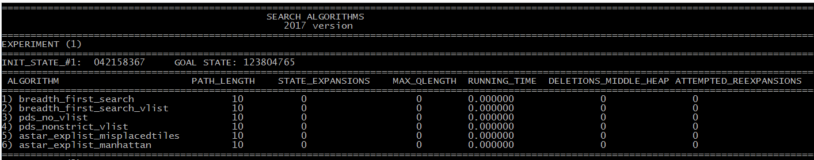
SEARCH
Batch run (run_all.bat)
Running the algorithms
Batch run
This type of run is used for running all the experiments required for all the algorithms.
Results are tabulated nicely, according to the requirements of the assignment.
Example:
Extra information for those who can implement the Heaps data structure for A* to get some bonus marks.

Slide 11
SEARCH
Batch run (run_all.bat)
Running the algorithms
main.exe "batch_run" "Breadth_First_Search" "042158367" "123804765"
main.exe "batch_run" "Breadth_First_Search_VList" "042158367" "123804765"
main.exe "batch_run" "PDS_No_VList" "042158367" "123804765"
main.exe "batch_run" "PDS_NonStrict_VList" "042158367" "123804765"
main.exe "batch_run" "aStar_ExpList_MisplacedTiles" "042158367" "123804765"
main.exe "batch_run" "aStar_ExpList_Manhattan" "042158367" "123804765"
Algorithm name
INITIAL STATE GOAL STATE
Example:
main.exe "batch_run" “breadth_first_search_vlist" "042158367" "123804765"
type of run = "batch_run" or "single_run"
Specific algorithm names are provided in the start-up codes to identify all the algorithms.

Slide 12
SEARCH
Animated Solution (run_one.bat)
Using graphics to show the animated solution
if(algorithmSelected == "breadth_first_search_vlist" ){
path = breadthFirstSearch_with_VisitedList(initialState, goalState, numOfStateExpansions, maxQLength, actualRunningTime);
} else if(…){
}…
…
if(typeOfRun == "single_run"){
if(path != "") {
AnimateSolution(initialState, goalState, path);
}
}
An animation function is provided for you.

Slide 13
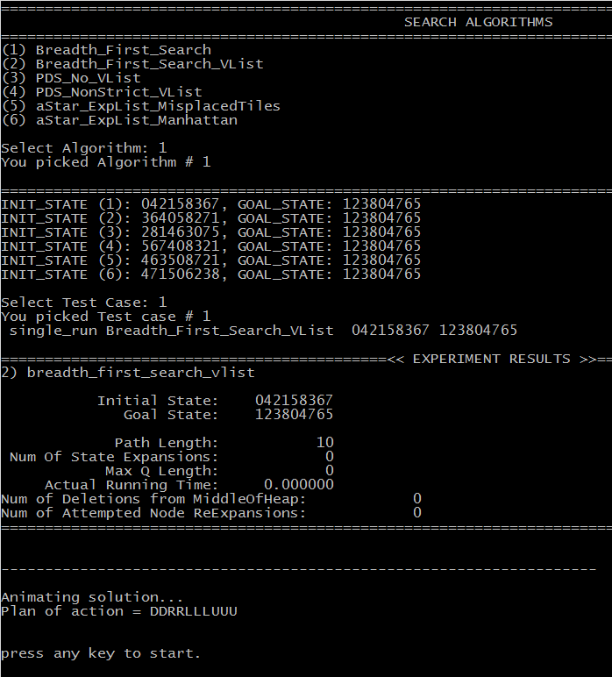
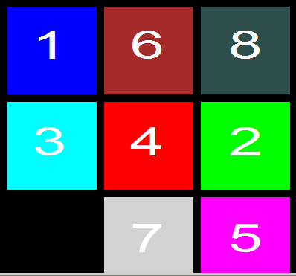
SEARCH
Animated Solution (run_one.bat)
.
Try run_one.bat

Slide 14
SEARCH
Some notes on implementing the Progressive Deepening Search
Pseudocode
C=1
Do Depth-limited DFS to max. depth C. If path is found, return it.
Otherwise, increment C and go to Step 2.

Slide 15
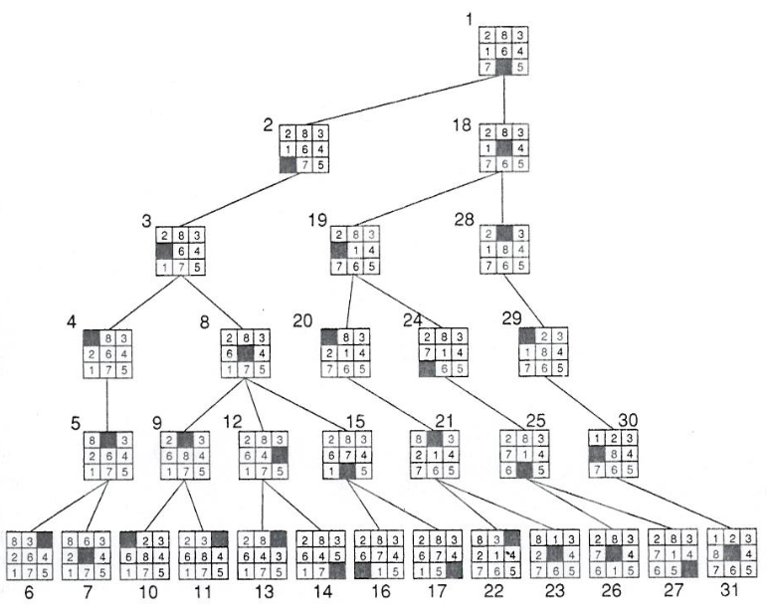
Depth-limited Depth-First Search
start
Successor generator: Left, Up, Right, Down
…
…
…
goal
Note: the complete search tree is not shown here.

Slide 16
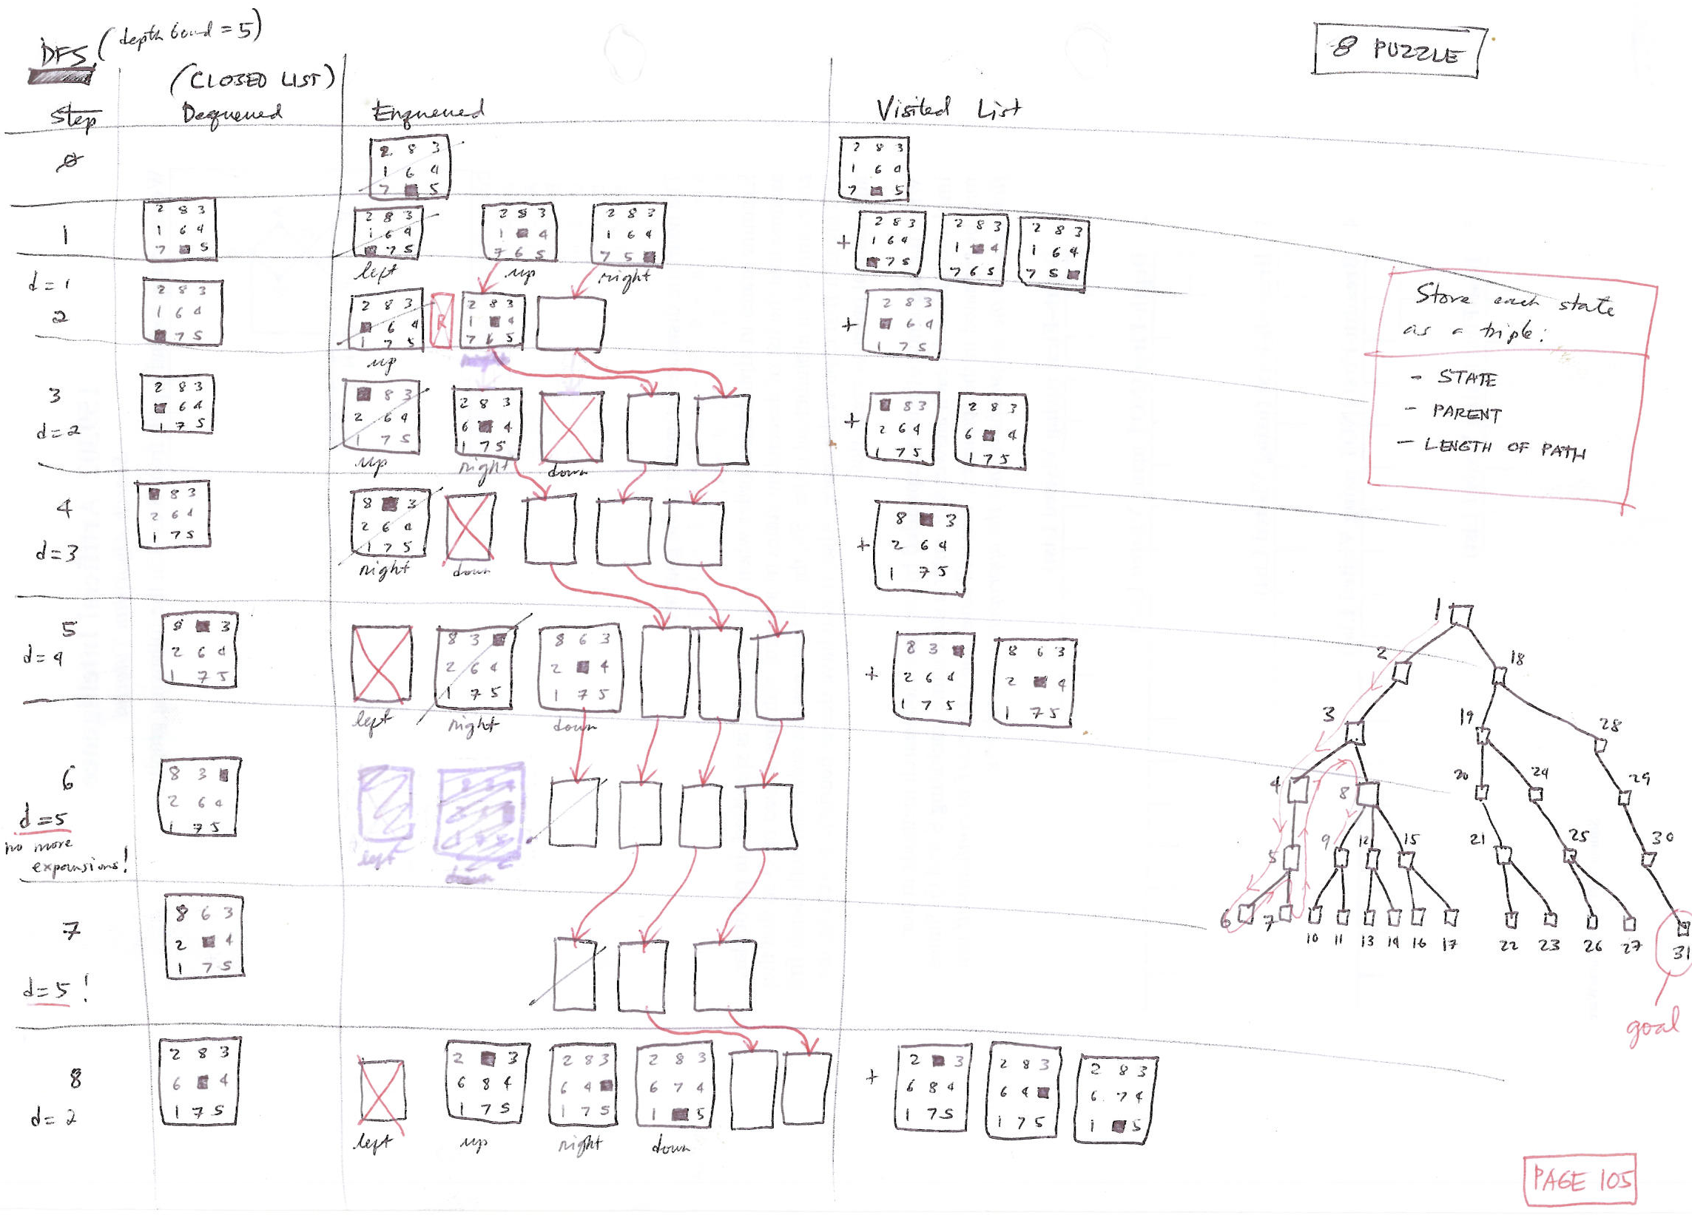
Depth-limited Depth-First Search
Successor generator: Left, Up, Right, Down

Slide 17
SEARCH
Admissible Heuristics
8 Puzzle: Move tiles to reach goal. Think of a move as moving an “empty” tile.
6 | 2 | 8
 | 3 | 5
4 | 7 | 1
1 | 2 | 3
8 |  | 4
7 | 6 | 5
S
G
Alternative underestimates of “distance” (number of moves) to goal:
Number of misplaced tiles (7 in the example above).
Sum of Manhattan Distance of tile to its goal location (17 in example above).
Manhattan Distance between (x₁, y₁) and (x₂, y₂) is │x₁ – x₂│ and │y₁ – y₂│.
Each move can only decrease the distance of exactly one tile.
The second of these is much better at predicting actual number of moves.

Slide 18
SEARCH
Admissible Heuristics
8 Puzzle: Move tiles to reach goal. Think of a move as moving an “empty” tile.
Number of misplaced tiles
1 |  | 3
8 | 2 | 4
7 | 6 | 5
1 | 2 | 3
8 |  | 4
7 | 6 | 5
S
G
Are we supposed to include the blank tile in the counting of misplaced tiles?
No.
What will be the consequence if we include it? Examine the case above.
The heuristic will no longer be admissible. A* will miss finding the optimal solution if the heuristic is not admissible.

Slide 19
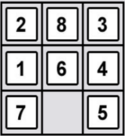
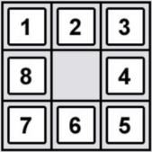
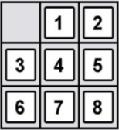
SEARCH
Hash function
A quick look-up of the status of states
Keys
Hash Values
index
e.g.
123456
false
Hash function
123457
true
Fixed length
Hash(key)
123458
true
Search Nodes
We can implement the Visited List/Expanded List using a hash table.
123459
true
.
.
.
.
.
.
A hash function could be used to map large data sets of variable length, called keys to hash values that are of a fixed length. The hash values may serve as indexes to an associative array.
However, hash values may have duplicates; therefore, may cause collision between keys.

Slide 20
SEARCH
Hash function
Visited List / Expanded List
A quick look-up of the status of states
Keys
Hash function
Hash Values
Fixed length
e.g.
000001
false
Hash()
362879
true
200000
true
Search Nodes
300879
true
.
.
.
.
.
.
.
.
.
.
.
.
Given a state, we can quickly check whether or not we have visited/expanded it previously.
362880
true
STATE

